Slide 1


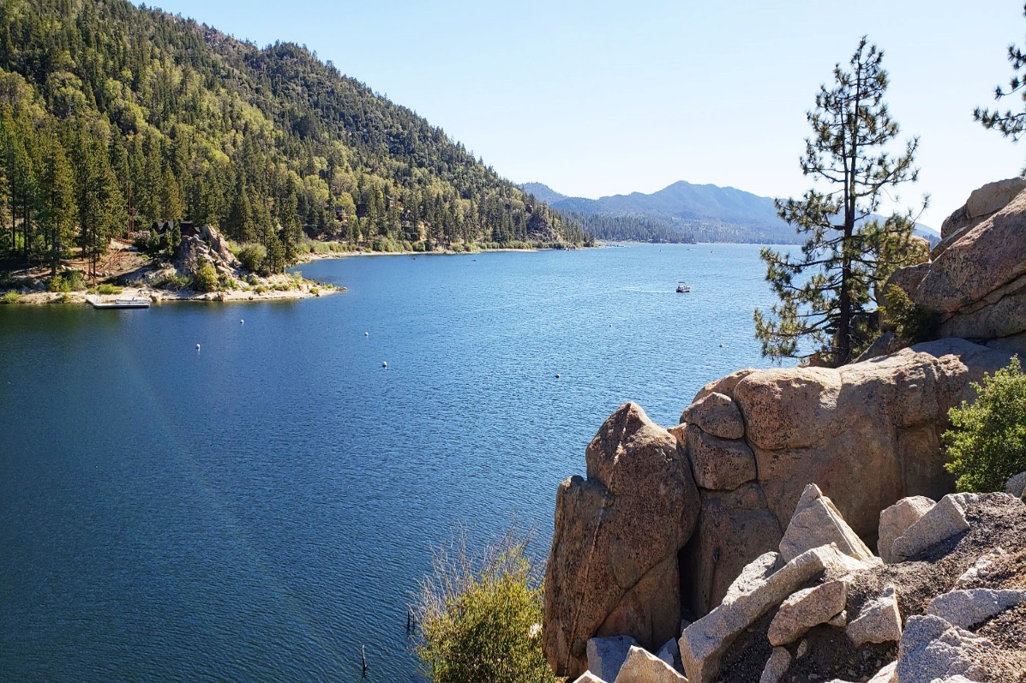

2022 Wildfire Mitigation Plan
Public Safety Power Shutoffs
June 17, 2022

Slide 2
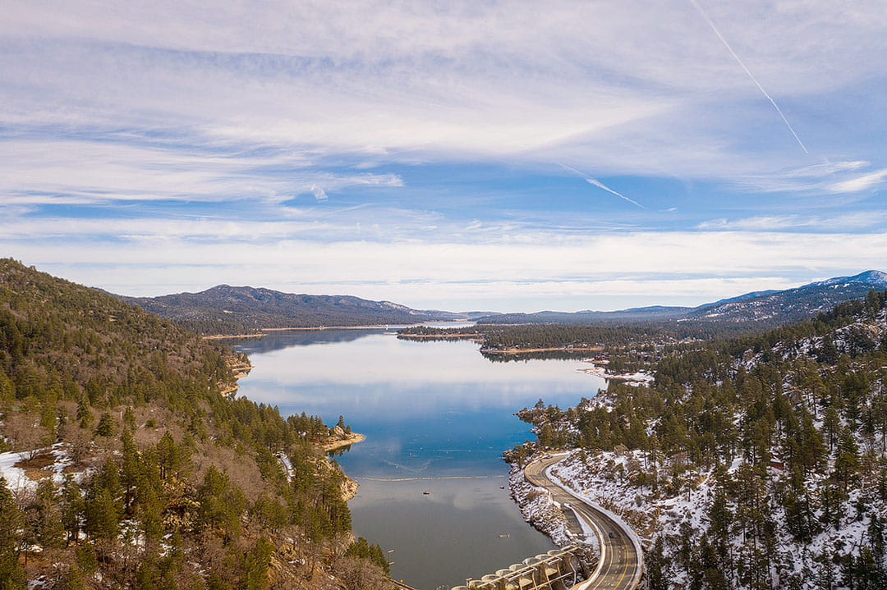


Powering The Mountain Since 1929
Overview
Decision-making Criteria
Exercises
Investing in Safety
Questions?

Slide 3

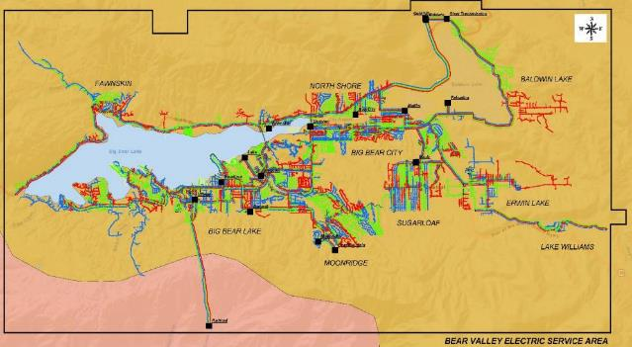
Powering The Mountain Since 1929
Overview
Location: 32 square miles of rural and mountainous terrain at approximately 7,000 ft. in San Bernardino Mountains (80 miles East of Los Angeles). Heavy tree and vegetation density and mostly dry environment (80.5%)
Key jurisdictions: County of San Bernardino, City of Big Bear Lake, US Forest Service
Customers: 24,562 total [23,065 residential and 1,497 commercial]
CARE: 2,032; Medical Device: 238; AFN: 14

Slide 4
Decision-making Criteria
Medical Baseline customer information is updated frequently via several list contributors and outreach methods.
Criteria based on system design limits, system condition, fuel availability, and likelihood of wildfire spread.
BVES would invoke PSPS if actual sustained wind or 3-second wind gusts exceed 55 mph and conditions are High for wildfire threat.
BVES did not have any PSPS events in 2021.
Based on analysis of weather in last 5 years BVES has not met criteria to invoke PSPS.
PSPS is measure of last resort in a progression of operational actions.
BVES developed ignition probability & consequence maps to better understand local wildfire risk.
In 2022, will gain access to real-time simulation modeling and live meteorological conditions mapping.
Chain of Responsibility | President | Utility Manager | Field Operation Supervisor | Utility Eng & WF Mitigation Supervisor | Customer Program Specialist
 | Overall responsible for the PSPS Plan and ensuring it is properly implemented, resourced, trained upon, executed, and updated as appropriate | Responsible for executing the BVES PSPS Plan | Responsible for directing operations in the field | Responsible for fire prevention planning and engineering design of the electric distribution, sub-transmission and substations | Responsible for the BVES Communications Plan

Slide 5
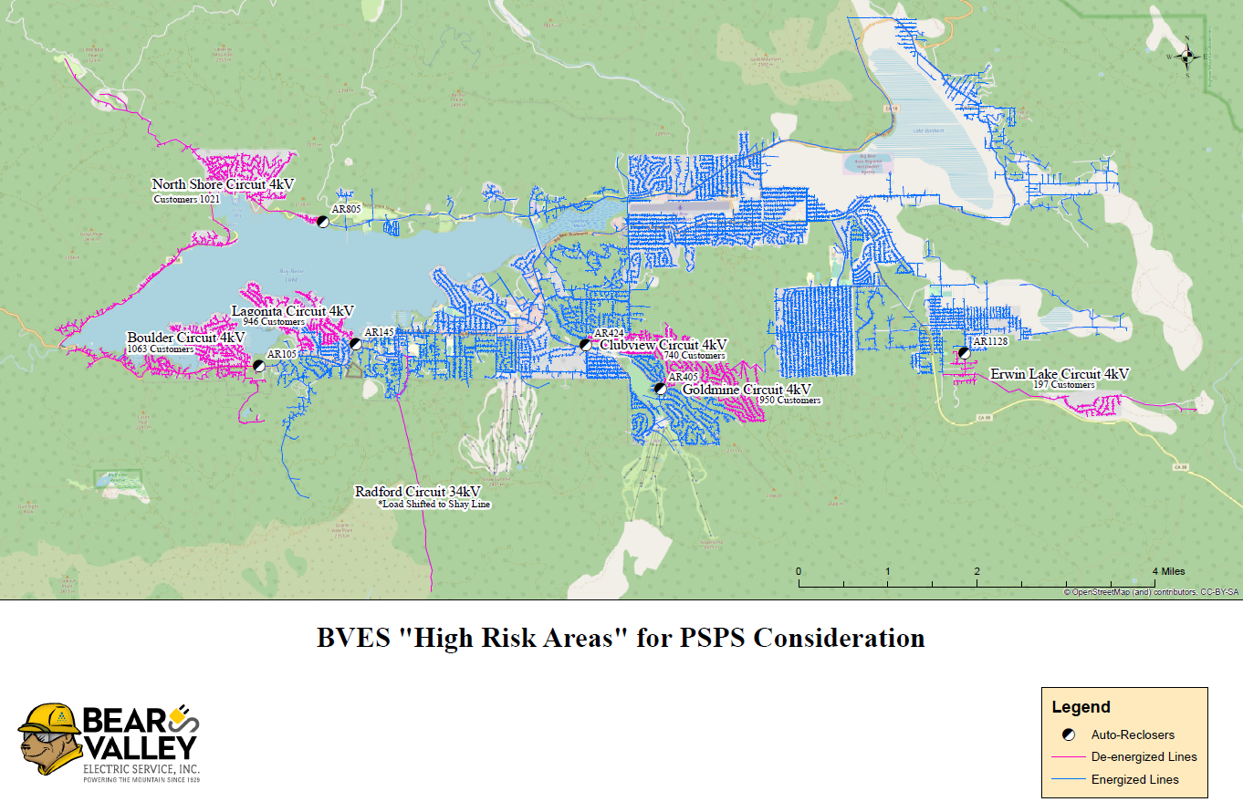
High Risk Areas for PSPS Consideration

Slide 6


Exercises
Last exercise was conducted on April 14, 2022
Several lessons learned, which resulted in updating BVES PSPS Policy and Procedure Plan
Next PSPS exercise planned for June 21, 2022:
Scenario will be a BVES directed PSPS event due to high winds and high wildfire threat conditions.
Will execute communication and notification protocols.
Will coordinate Community Resource Center and amenities.
Will deploy Wildfire Response Team.
Will conduct re-energization patrols.
Will exercise all levels of communications with local government, agencies, stakeholders, and the public.
Will encourage local government, agencies and stakeholders to participate.

Slide 7
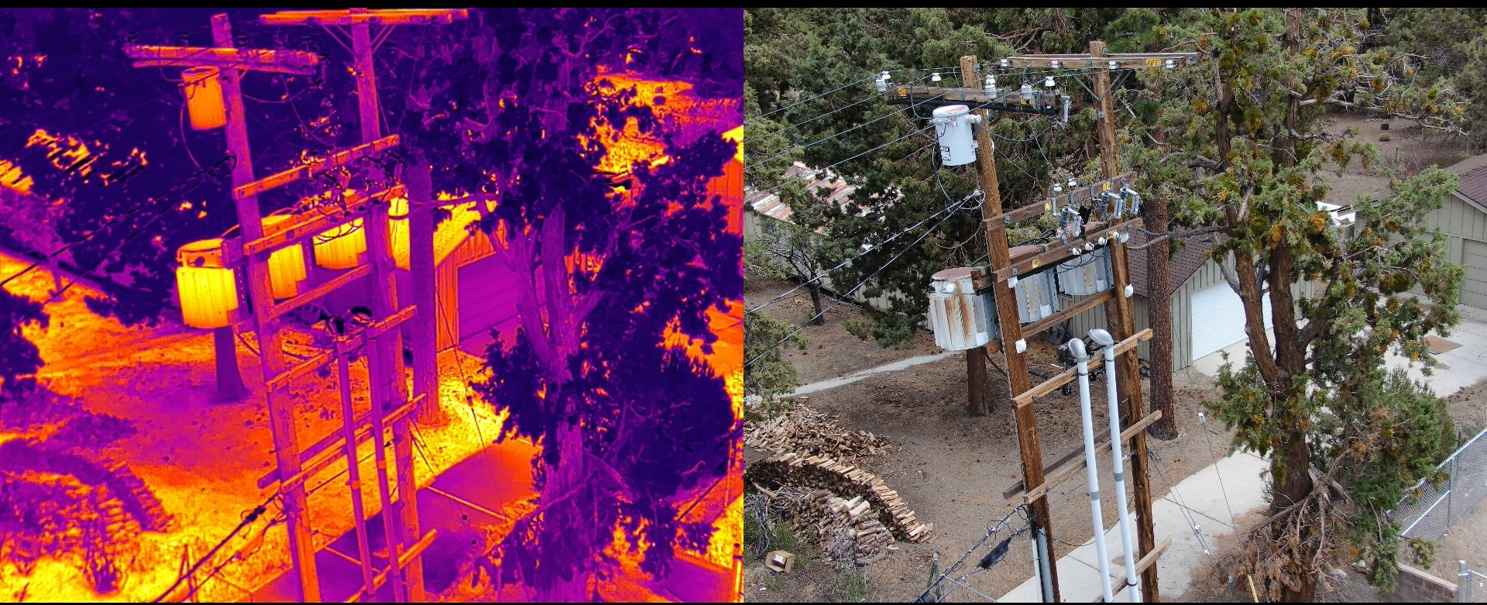

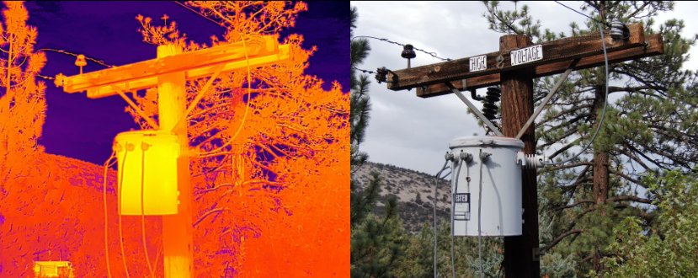
Investing in Safety
Partnership with Davey Resource Group, Inc.
Following a successful program launch in 2021, BVES has extended their partnership with Davey Resource Group, Inc. (DRG) to conduct Unmanned Aerial Vehicle (UAV) fly-over inspections of its sub-transmission and distribution system throughout the months of April and May.
Covered Wire Program
BVES strives to exceed requirements in its WMP by using a variety of safety, fire-hardening and grid-hardening strategies to reduce and eliminate the risk of wildfires. As drought and dryness are expected to continue across California for years to come, the utility is taking measures to protect lives and the land. For example, BVES became the first IOU in the U.S. to install fire-resistant-non-propagating covered wire across its service territory. The all-aluminum alloy conductor wire replaced existing 34-kV lines running throughout the utility’s high fire-threat areas.

Slide 8
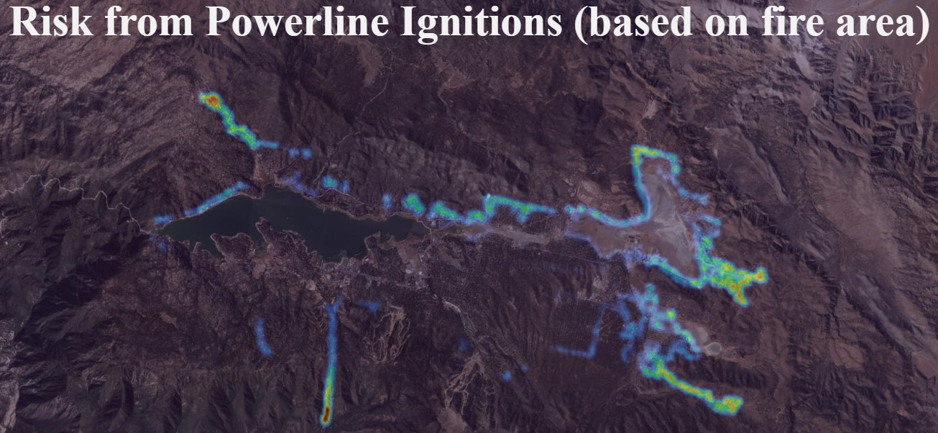
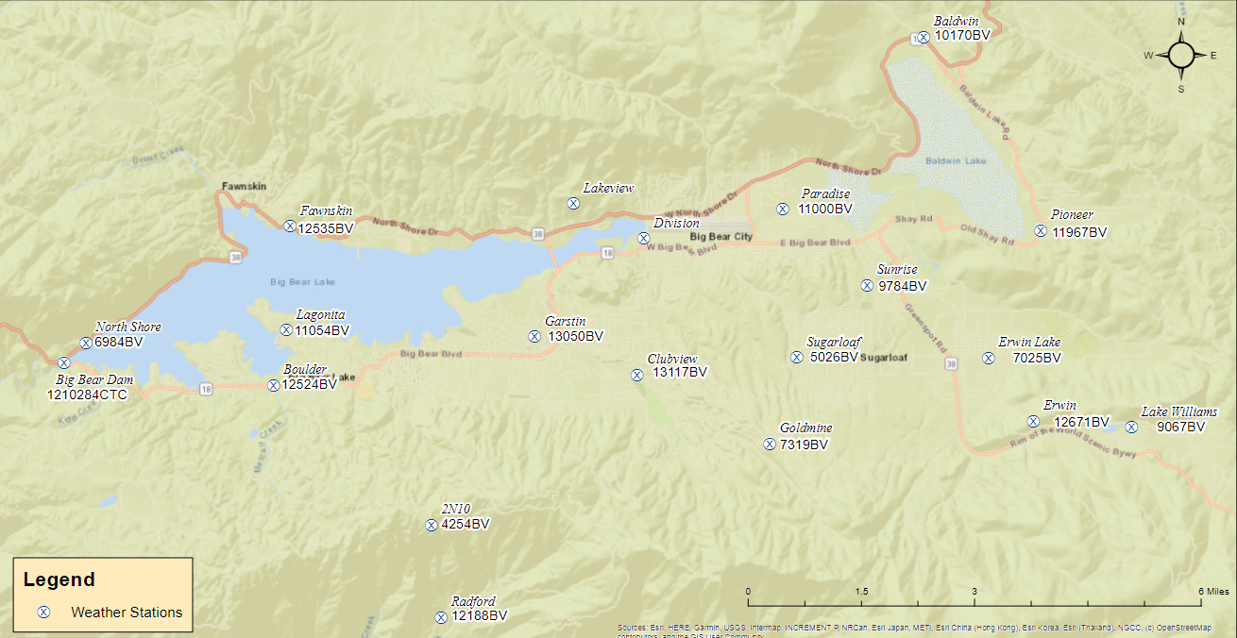
Investing in Safety – WMP Execution Performance
Risk Assessment & Mapping
Developed ignition probability risk and consequence maps
Plans for 2022: Securing access to on-demand weather platforms for real-time simulations
Situational Awareness & Forecasting
Two final weather (of 20) stations installed in 2021
15 installed HD cameras for area-wide coverage
Grid Design & System Hardening
Hardened 20 bare wire circuit miles, 12 of which hardened in 2021
Technical/safety upgrades to the Palomino station
Replaced all 862-remaining expulsion (conventional) fuses.
74 legacy tree attachments removed.
BVES completed its Evacuation Route Pilot Program – with pole/cross-arm hardening
All main evacuation routes will be hardened in 2022.

Slide 9
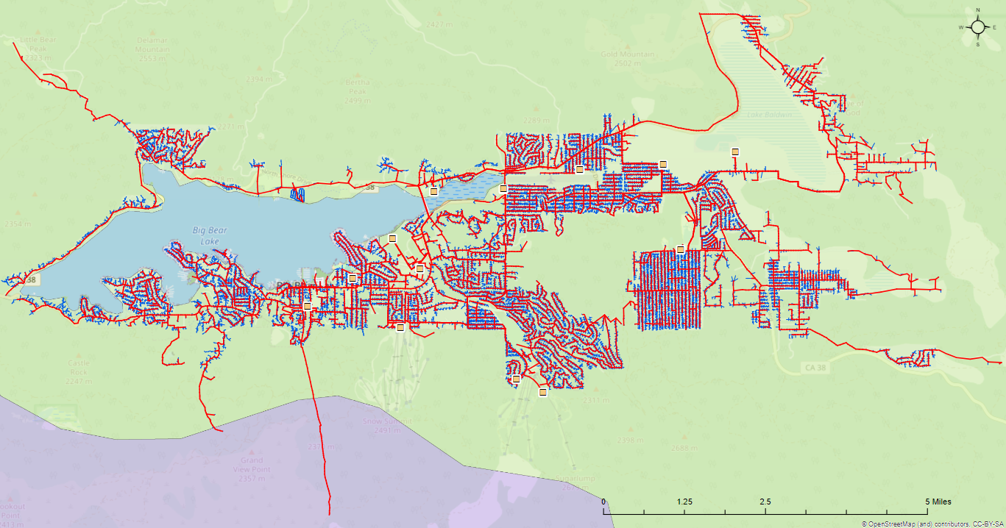
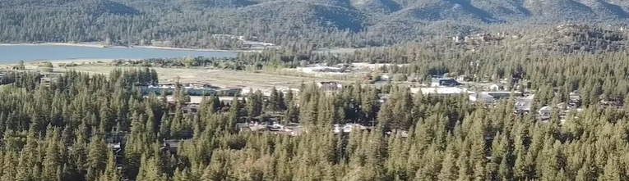
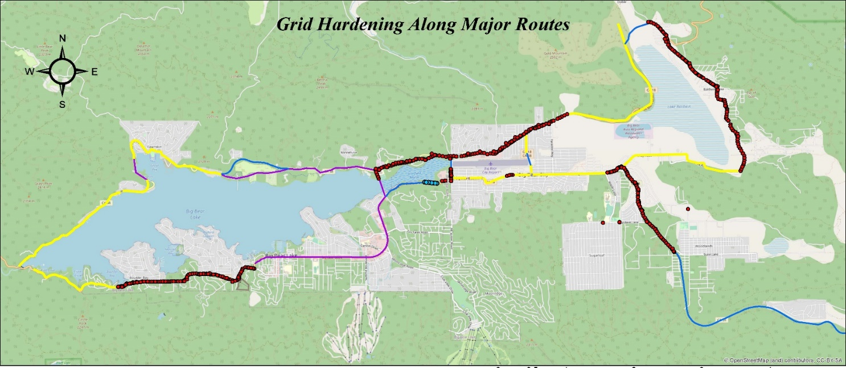
Investing in Safety – WMP Execution Performance
Asset Management & Inspections
Territory-wide inspections using UAVs and ground patrols covering 211 circuit miles
An additional 78.56 circuit miles were LiDAR surveyed, raising total to 289.56 above the 211-circuit mile target
Enhanced its QA/QC of inspections
3rd-party ground patrols with contracted forester
Vegetation Management & Inspections
Annual detailed inspections exceeded planned 50 circuit mi. (54.9)
UAV and ground patrol inspections covered 211 circuit miles along with the LiDAR inspections
Vegetation density along ROWs by 18%.
Developed QA/QC procedures for additional validation
Grid Operations & Operating Protocols
Continued improvement for existing emergency preparedness and response program
Further refinement of PSPS plan documentation targeted for mid-2022

Slide 10
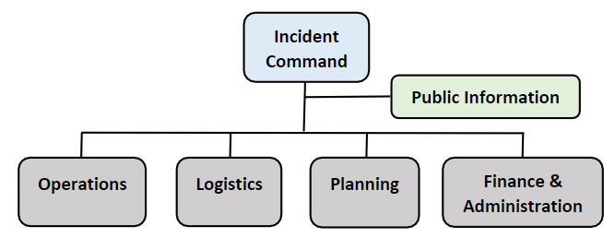
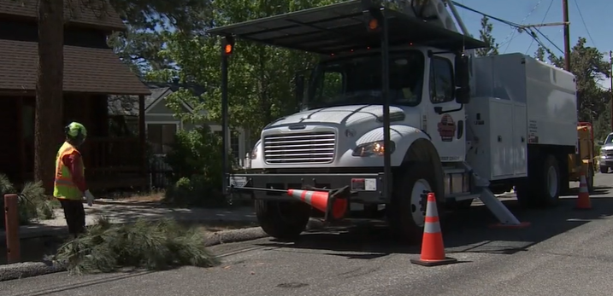
Investing in Safety – WMP Execution Performance
Data Governance
Addressed administrative gaps related
Improved GIS data/mapping and continued refinement of its data schema mapping practice.
Resource Allocation Methodology
BVES has met its targets for adequate resources in 2021
For any immediate personnel needs, BVES hires outside consultants
Emergency Planning & Preparedness
BVES reports no emergencies, PSPS events, or fire incidents in 2021, though remains prepared if program protocols are required
Continued regular engagement with emergency responders/stakeholders
Stakeholder Cooperation & Community Engagement
602 engagement materials issued above target of 360 units
BVES is improving AFN customers mapping within its GIS system and has issued self-identification notices to enhance tracking

Slide 11

Powering The Mountain Since 1929
Questions?

